Slide 1
CS 316: Introduction to Deep Learning
Generative Models
Week 15
Dr Abdul Samad

Slide 2
Lecture Outline
Generative Models vs. Discriminative Models
Types of Generative Models
Different Variants of GANs
Generative Adversarial Network (GAN)
Discriminator
Generator
BCE Loss function
Training GANs

Slide 3








Generative Models vs. Discriminative Models
Discriminative models Generative models
Features
Class
Noise Class
Features

Slide 4
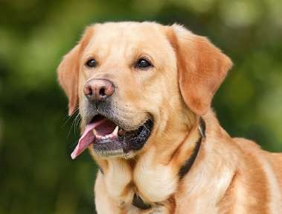
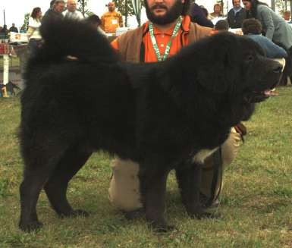
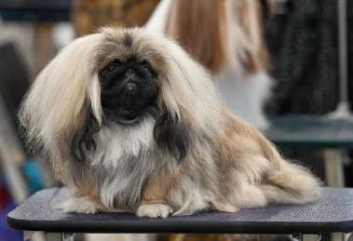
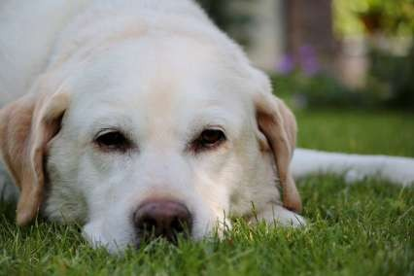
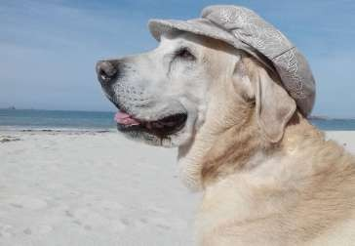
Generative Models vs. Discriminative Models
Discriminative models
Features Class
Generative models
Noise Class
Features

Slide 5
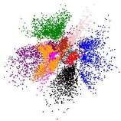
Generative Models
Variational Autoencoders
Encoder
Decoder
Latent Space
Decoder
Available from: https://arxiv.org/abs/1804.00891

Slide 6

Generative Models
Generative Adversarial Networks
Compete
Generator
Discriminator
Random Noise
Generator
Available from: https://arxiv.org/abs/1804.00891

Slide 7
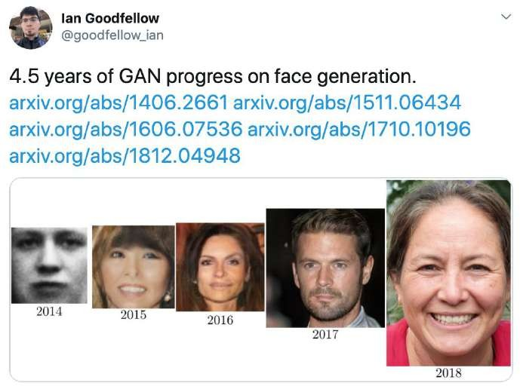
GANs Over Time
2014
Black and white
Colored photo-realistic
2018

Slide 8

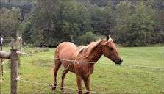
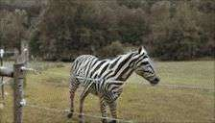
GANs for Image Translation
From one domain to another
CycleGAN
Available from: https://ieeexplore.ieee.org/document/8953676

Slide 9


GANs for Image Translation
GauGAN
Doodles
Pictures
Available from: https://ieeexplore.ieee.org/document/8953676

Slide 10
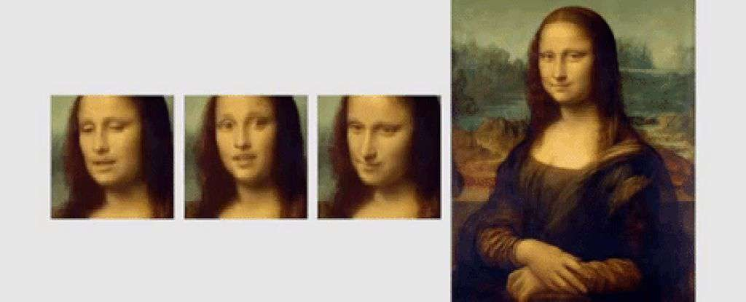
GANs are Magic!
Available from: https://arxiv.org/abs/1905.08233

Slide 11
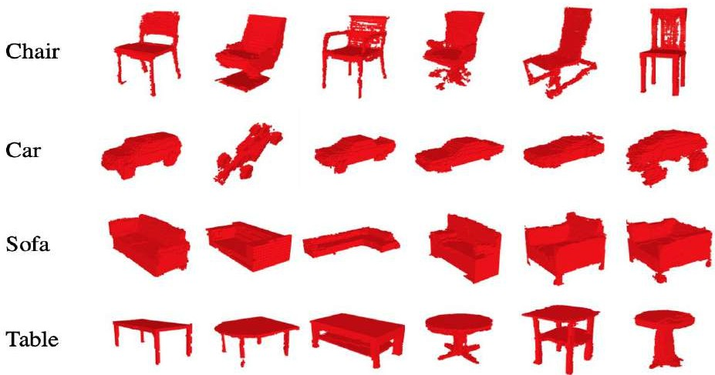

GANs for 3D Objects
3D-GAN
Generative Design
Available from: https://arxiv.org/abs/1610.07584

Slide 12





Companies Using GANs
Next-gen Photoshop
Text Generation
Data Augmentation
Image Filters
Super-resolution

Slide 13
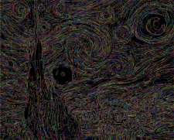

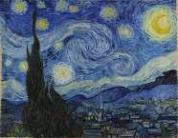
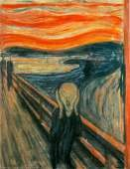
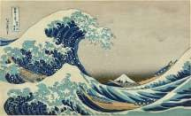
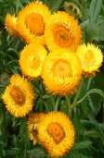

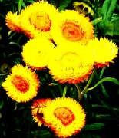
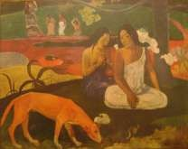
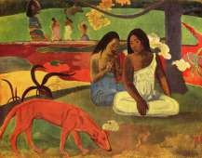
Generative Adversarial Network
Generator learns to make fakes that look real
Discriminator learns to distinguish real from fake.

Slide 14
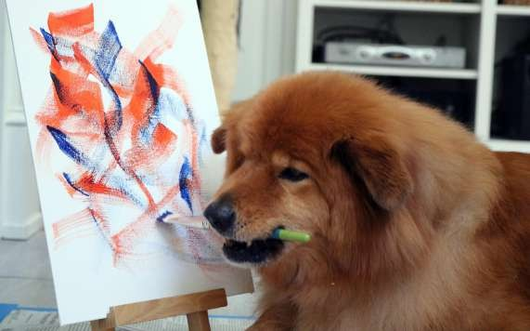
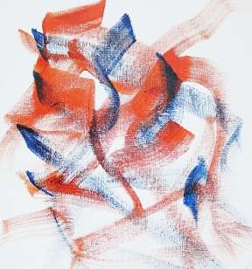
Generative Adversarial Network
Generator learns to make fakes
that look real
Doesn’t know how it should look
I don’t know what I’m doing

Slide 15
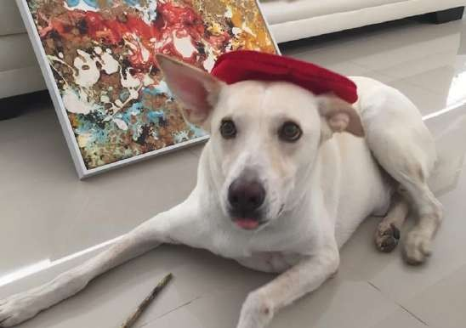
Generative Adversarial Network
Discriminator learns to distinguish
real from fake
I don’t know what I’m doing, either

Slide 16

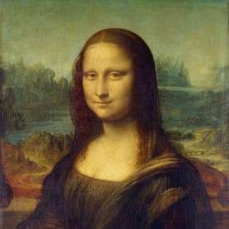

The Game Is On!
5% Real
80% Real
40% Real

Slide 17
Discriminator
deeplearning.ai

Slide 18
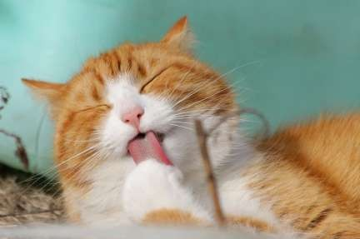
Classiﬁers
Distinguish between different classes
Turtle
Bird
Classiﬁer
Cat
Fish
Dog

Slide 19




Neural Networks
0.45 Cat
0.45 Dog
0.10 Bird

Slide 20
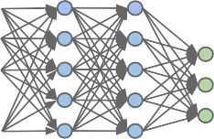



Classiﬁers (training)
Parameters
Cost
Output vs Label
Features
Output
Discriminator
Labels

Slide 21

Classiﬁers
Turtle
Bird
Cat
Dog
Fish

Slide 22


Classiﬁers
Conditional Probability
Class
Features

Slide 23

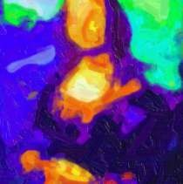
Discriminator
0.45 Cat
0.45 Dog
0.10 Bird

Slide 24
Discriminator
0.45 Cat
0.45 Dog
0.10 Bird
0.85 Fake

Slide 25
Discriminator
Fake
Class
Features

Slide 26

Discriminator
Fake
Fake
Class
Features

Slide 27
Generator
deeplearning.ai

Slide 28
Generator
Turtle
Generates examples of the class
Bird
Generator
Cat
Dog
Fish

Slide 29
Neural Networks
Noise (random features)

Slide 30
Neural Networks
Different outputs at every run!
Noise (random features)

Slide 31
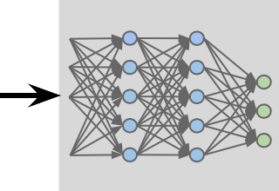
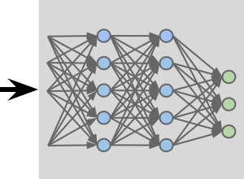



Generator: Learning
Parameters
Noise
Cost
Features
Output
Generator
Discriminator

Slide 32
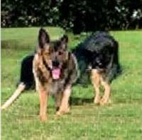
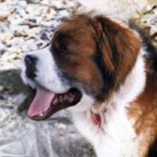
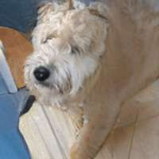
Sampling
Saved Generator

Slide 33
Generator
Turtle
Bird
Cat
Dog
Fish

Slide 34
Generator
Conditional Probability
Features
Class

Slide 35
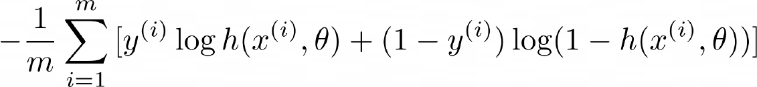

BCE Cost Function
Prediction
Label
Features
Average loss of the whole batch
Parameters

Slide 36
BCE Cost Function

Slide 37

BCE Cost Function
0
any
0
1
1
0.99 ~0
~0 -inf
Relevant when the label is 1

Slide 38
BCE Cost Function
1
any
0
0
0
0.01 ~0
~1 -inf
Relevant when the label is 0

Slide 39
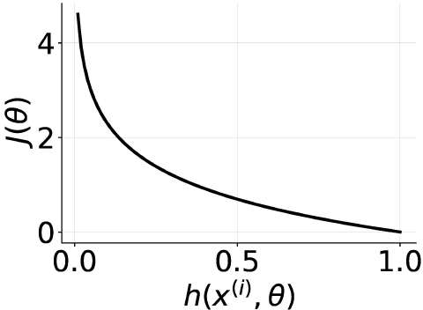
BCE Cost Function

Slide 40
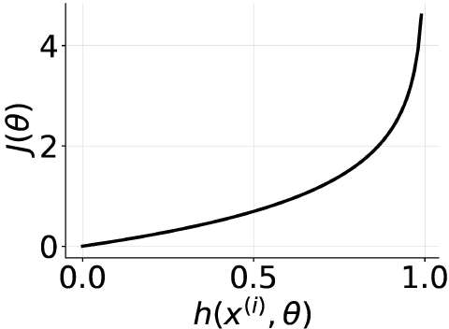
BCE Cost Function

Slide 41

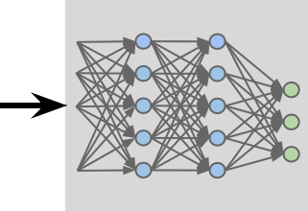
GANs Model
Reals
Output
Discriminator
Noise
Distinguish the fakes
and the reals
Make the fakes look like the reals
Fakes
Generator

Slide 42


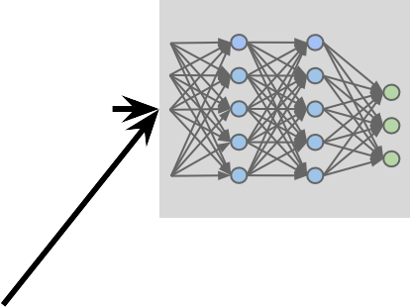
Training GANs: Discriminator
Both real and fake examples
Parameters Discriminator
Cost
Noise
Features
Output
Generator
Discriminator
BCE with labels for real and fake

Slide 43


Training GANs: Generator
Parameters Generator
Noise
Features
Output
Cost
Generator
Discriminator
Only fake examples
BCE with all labels equal to real

Slide 44
Training GANs
Discriminator Output
Fakes as 100% fake
Superior Discriminator
No way to improve

Slide 45
References
DeepLearning.AI

